Slide 1
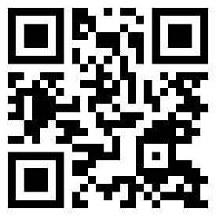
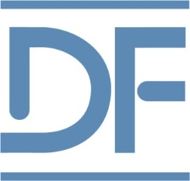
The Dermatology Foundation has supported & advanced my career.
Dermatology Foundation
SHAPING THE FUTURE OF DERMATOLOGY

